Slide 1
Plan Year 2023 Virginia ACA
Carrier Teleconference
Today’s topics include:
  Important Dates
  Virginia ACA Rate Filing Information
  SERFF Public Access
  Health Care Shared Savings Incentive Programs
  Mental Health Parity Compliance
  Binder Filing Reminders
  Commonwealth Health Reinsurance Program
  Virginia Legislation
  EHB Percent of Total Premium
  Bureau’s COVID-19 Information Page

Slide 2
Bureau of Insurance Presenters
David Shea, Health Actuary
  David.Shea@scc.virginia.gov
Sharon Holston, Manager, Plan Management & ACA Forms
  Sharon.Holston@scc.virginia.gov
Brant Lyons, Principal Insurance Market Examiner (Market Conduct)
  Brant.Lyons@scc.virginia.gov
Julie Blauvelt, Deputy Commissioner (Life & Health)
  Julie.Blauvelt@scc.virginia.gov

Slide 3
Important Dates (2022)
April 1: SERFF public access suspended for health form, rate, and binder filings and revisions made on or after this date up to the BOI rate presentations
April 15: Form filing deadline for ALL ACA health carriers (excludes SADPs)
April 29: Form and rate filing deadline for carriers submitting SADPs to be exchange-certified
May 13: Binder filing deadline for carriers offering SADPs to be exchange-certified
May 20: Rate filing deadline for ALL ACA health carriers

Slide 4
Important Dates (2022)
May 20: Binder filing deadline for carriers offering individual and small group health insurance coverage inside or outside the exchange
July 15: Deadline for voluntary service area revisions and rate filing revisions; revisions after this date can be made based only at request of BOI. Please note this date is different from the CMS deadline
July 15: New for PY2023 - Deadline for voluntary changes to the Prescription Drug Template. Revisions after this date can be made based only at the request of the BOI
August: Rate presentations to the Commission (tentative date); SERFF public access restored
August 17: Deadline for data transfer to CMS

Slide 5
Virginia ACA Rate Filing Information
VA ACA Rate Filing Template Changes
Reinsurance
  Listed as a separate pricing factor on Tab VII, Table 11
  Tab VIII (Rate Presentation exhibits) replaces “Other Changes” with “Reinsurance”
Silver Plan Variants
  Actual and expected members added to Tab V
Bedford City
  Removed from Tab VI, A & B as it is no longer a separate city
Defrayed non-EHBs
  Added as a separate entry on Tabs I, IV, V & VII
  Additional ACA Rate Filing Information
  Elimination of tobacco surcharge
  Assume no ARPA subsidies for 2023

Slide 6
Health Care Shared Savings Incentive Program
Carriers are not required to demonstrate cost effectiveness (or lack thereof) every year but must submit updates for review prior to offering any Program that varies from the previously filed and reviewed Program.
Requests for exemption must be filed by March 15 in the year prior to the requested exemption year.
Beginning April 1, 2022, carriers that are not exempt are required to file the “Health Care Shared Savings – Annual Report” in SERFF (filing type “Shared Savings Annual Report”). The report template can be found at: Virginia SCC - Life & Health
Report is due April 1 in each subsequent year
Refer to Administrative Letter 2020-01 for more information

Slide 7
Mental Health Parity (MHPAEA) Compliance
Virginia’s MHPAEA Self-Compliance Tool continues to be available on the BOI website
  Carriers are encouraged to use this tool to assess their MHPAEA compliance
  The BOI currently uses this tool during market conduct exams
  Submission of this tool is not required initially with 2023 form filings, but benefit design and administration should be compliant with the requirements it outlines
  Carriers should be prepared to provide NQTL comparative analyses upon request as part of market conduct exams, consumer complaints, and form filings

Slide 8
Mental Health Parity (MHPAEA) Compliance (cont)
QTL/Financial Requirement Guidance Document
  Includes required steps for compliance in 2023 filings
  Must correctly recognize that some services can treat both Medical/Surgical and Mental Health/Substance Use Disorder conditions (nutritional counseling, occupational therapy, etc.)
  Must determine expected claim dollar amounts correctly and apply predominant level to MH/SUD benefits

Slide 9
Mental Health Parity (MHPAEA) Compliance (cont)
Intend to revise Administrative Letter 2020-03 (Autism Spectrum Disorder)
  ASD is a Mental Health condition
  Applied Behavior Analysis is an EHB and must be covered by QHPs to comply with MHPAEA in 2023 filings and going forward
  Final Guidance Forthcoming

Slide 10
Binder Filing Reminders (2022 dates)
May 13th - binder filing deadline for SADPs
May 13^{th -} binder filing deadline for any carrier who wants to take advantage of the early bird transfer
May 20th – binder filing deadline for Individual and Small Group coverage inside and outside the exchange.
We strongly encourage carriers to run the appropriate Review Tools provided by CMS prior to submission of a binder, and prior to each submission of any revised templates. These tools are used to guard against incorrect information being provided on Healthcare.gov.

Slide 11
Binder Filing Reminders (cont.)
Following the date of the initial transfer, June 15, 2022, a carrier subject to this date can only make voluntary changes to the information in any form, rate or binder filing if the BOI allows the change. The carrier must make the request and submit the proposed revision as a Note to Reviewer in SERFF and wait for the BOI’s response prior to submitting the voluntary change in the filing. This does not apply to BOI requested changes.
The Virginia Plan Schedule Comparison is included as a tab (tab IX) on the Virginia ACA Rate Filing Template for all individual and small group plans inside and outside the exchange.
  The form number of the schedule of benefits associated with each plan should be entered in Column E of tab IX.
SADP carriers must still complete the Virginia Plan Schedule Comparison and attach it under the Supporting Documentation tab in each binder.

Slide 12
Binder Filing Reminders (cont.)
The Associate Schedule Items (ASI) tab in the binder must include all forms and rates filed for each plan. Each form must include a valid link to the actual form submission. Each plan must include a link to a valid rate submission.
The VA Rate Filing Template should be attached under the Supporting Documentation tab in each binder. The rate sheet that is attached to the Rate/Rule Schedule in the rate filing should be attached under the ASI and linked to the corresponding rate filing for each plan.
For carriers who use a different filing instance for rates and are not able to complete the rate portion of the ASI tab, a document presenting the same rate information that is required, and the SERFF tracking number of the Rate Filing, must be submitted under the Supporting Documentation tab in the binder and must be kept updated.
Carriers must update all related forms, rates and binder filings if changes are made to one of these filings.

Slide 13
Binder Filing Reminders (cont.)
Reminder: Carriers who include coverage for elective abortion for QHPs on the Exchange should report such coverage as an Addition to EHB.
Plan Marketing Names must not include any misleading information.
The draft 2023 Notice of Benefit and Payment Parameters (NBPP) includes a proposed requirement that carriers offer a standardized QHP option at every product network type, metal level and throughout every service area that they offer non-standardized QHP options. Further information regarding standardized plans may be found in the draft 2023 NBPP.
The BOI will review plans using federal guidance that all plans within a product must share the same drug formulary (also referred to as “covered drug list”), and tier structure.

Slide 14
Commonwealth Health Reinsurance Program
SCC applied for a 1332 state innovation waiver to decrease premiums in the individual market by 15% for 2023: Virginia SCC - Reinsurance Waiver
Parameters requested are included in the application.
Will request rate adjustments upon approval by federal agencies.
Will ask for carriers to show impact of this change at rate presentations.
HB 842/SB 338 – removed provisions that could not be implemented as written.

Slide 15
Virginia Legislation
Review legislation for forms and rates development
  Forms checklists will provide some direction
SB 337 – Authorizes the State Corporation Commission to issue rules and regulations related to accident and sickness insurance minimum standards and excepted benefits.
  Informal comment period
HB 675/SB 422 – Tobacco Surcharge eliminated as an adjustment factor for 2023 rates and beyond. Will ask for carriers to show impact of this change at rate presentations.
HB 884/SB 195 – Authorizes the formation of self-funded MEWAs for the purpose of offering health plans to employer groups
  Must obtain a license from SCC according to regulations to be promulgated
HB 925/SB 405 – Requires coverage for medically necessary prosthetic devices, including myoelectric, biomechanical, or microprocessor-controlled prosthetic devices, for large groups.

Slide 16
Virginia Legislation (Continued)
HB 431/SB 449 –
  QHPs may, but are not required to, provide coverage for state-mandated non-EHBs.
  Enteral nutrition mandate expanded the original coverage of the benchmark plan. Any portion of the benefit above the benchmark, is not part of EHB premium.
  Benchmark covers:
    Infusion of special medical formulas as the primary source of nutrition for persons with inborn errors of amino acid or organic acid metabolism, metabolic abnormality or severe protein or soy allergies.
    Excludes nutritional formulas and dietary supplements that are available over the counter and do not require a written prescription.

Slide 17
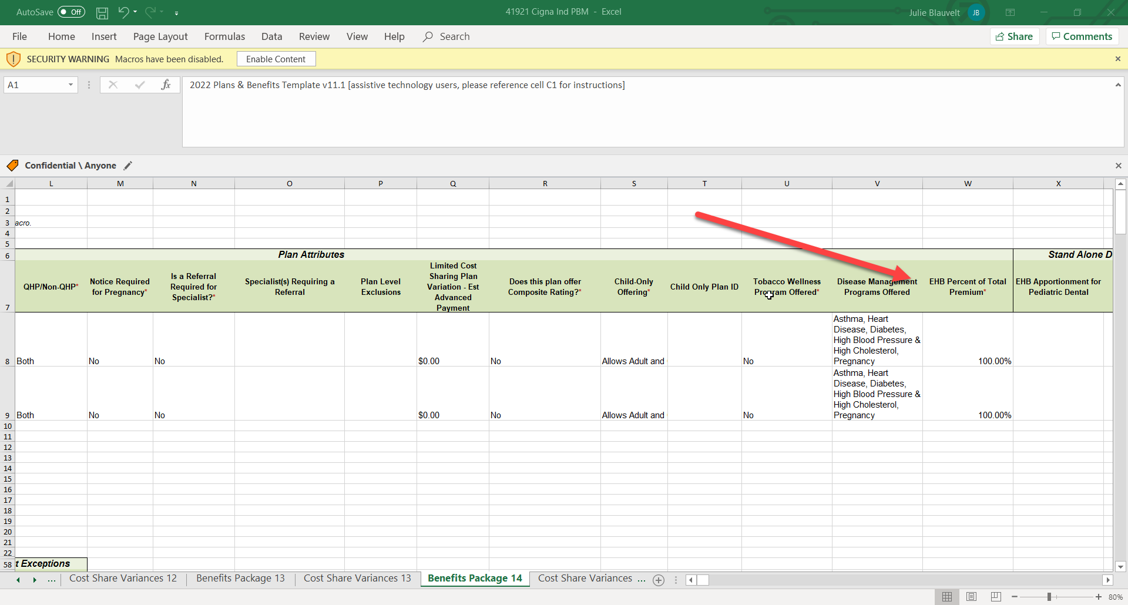
Plans & Benefits Template – EHB Percent of Total Premium
Any benefits provided above EHB should reduce this amount.

Slide 18


Virginia Rate Filing Template – Five Areas
Breakout State-mandated versus non-State-mandated non-EHB coverage – no State-mandated non-EHB coverage for PY 2023.
Information should not conflict with Plans & Benefits Template
Tab 1, Tables 2 and 3
Tab IV, Table 6

Slide 19
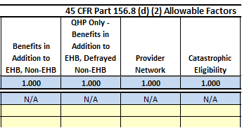
Virginia Rate Filing Template – Five Areas
Tab V, Table 8
Tab VII, Table 12

Slide 20
COVID-19 Updates
Bureau Webpage for COVID-19 Updates: Virginia SCC – Companies. The response to COVID-19 information is under New to Review.

Slide 21
ACA Form/Rate Filing Questions
ACAFilingInfo@scc.virginia.gov

