Slide 1

State Corporation Commission Bureau of Insurance
2024 ACA Rate Presentations
August 9, 2023

Slide 2
Presentation Overview
Welcome and Introduction
Alexander Skirpan, Chief Hearing Examiner,
State Corporation Commission (SCC)
Broad Overview of Virginia’s Individual and Small Group Health Insurance Markets and Key Issues
Julie Blauvelt, Life & Health Division Deputy Commissioner, SCC Bureau of Insurance
Discussion of Key Observations – Virginia’s Individual and Small group Health Insurance Rates
David Shea, Health Actuary, SCC Bureau of Insurance
Presentation of Carriers’ Rates
Carrier Presenters
Closing
Alexander Skirpan

Slide 3
Number of Carriers in Virginia in the Individual Market - On and Off Exchange
*2024 QHP applications received through SERFF

Slide 4
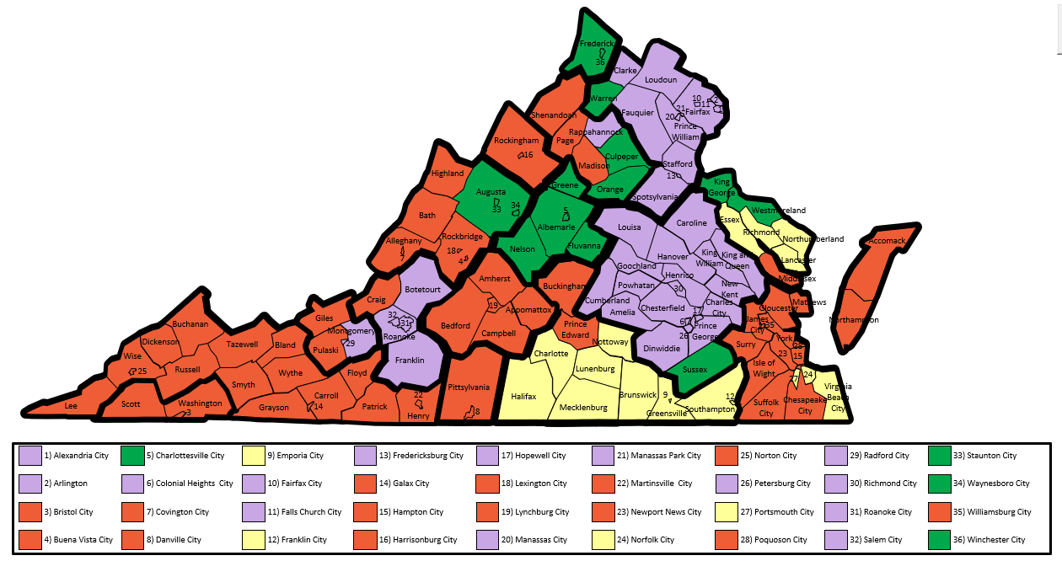
2024 Individual Market On Exchange - Carrier Service Area Applications
As of 8/1/2023

Slide 5
Virginia Individual Market Share by 2024 Projected Covered Lives ¹
¹ Covered lives based on carrier projected member months submitted in the carrier Virginia Rate Filing Templates

Slide 6
Virginia Individual ACA Total Enrollment and Average Premium PMPM 2019 – 2024
Source: 2022 and prior - Experience period data submitted in carrier ACA filings.
2019 and 2020 exclude data from Virginia Premier with approx. 5000 members. 2022 data excludes Bright Health.
2023 and 2024 - projected PMPM premium and enrollment from carrier ACA filings, actual 3/1/2023 enrollment for 2023.

Slide 7
Reinsurance Program waiver application
The General Assembly directed the SCC to apply for a waiver that provides federal funding to Virginia to largely support a reinsurance program for the individual ACA market. CMS approved the program for up to 5 years beginning in 2023.
The program reduces health carriers’ costs, reducing premiums. Persons who purchase individual coverage but do not receive federal subsidies (APTCs) benefit the most from the program.
The law sets the goal of the program to decrease premiums by up to 20% depending on available revenue.
The SCC relies on the General Assembly money committees to target the level of funding Virginia will contribute to the program. For 2023, legislators selected a 15% premium reduction target with an estimated cost to Virginia of about $69 million.

Slide 8
2023 Reinsurance program
The 2023 program targeted a 15.6% premium reduction on average.
Federal agencies granted approval of the program that pays a portion of expensive claims using a combination of state and federal funds.
Estimated federal funds: $331,877,124
Estimated Virginia funds: $43,424,482
Reinsurance program parameters set by SCC reduced rates on average 19.5% from what they would have been with no reinsurance. Rates were reduced 17.2% from 2022 rates on average.

Slide 9
2024 REINSURANCE PROGRAM
An actuarial study* found that many people continued to purchase individual coverage in Virginia without federal advance premium tax credits. This raises the projected state costs for the program.
The SCC did not receive agreement from the General Assembly money committees on a level of funding or premium reduction for the 2024 Program.
A program could cost the state between $36 to more than $65 million for just a 5% premium reduction.
Virginia could expect to receive more than $100 million in Federal funds for a program of that size.
For 2024, the SCC established a 0% premium reduction for the program, thereby resulting in a rebound from the previous year’s rate levels.
For more information, go to: https://scc.virginia.gov/pages/Reinsurance-Waiver
* Oliver Wyman 2024 Reinsurance Modeling Results, April 14, 2013 – funded by a grant from U.S. Health and Human Services

Slide 10
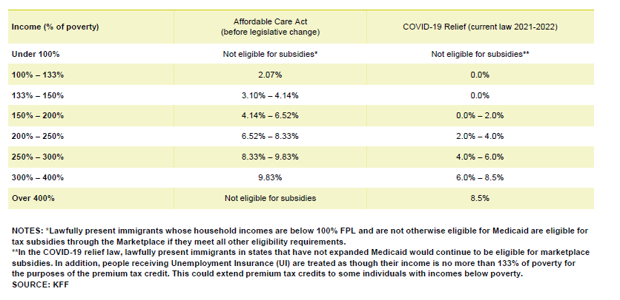
ARPA ACA Subsidies

Slide 11
2023 Marketplace Open Enrollment Period
Number of Consumers with a Marketplace Plan Section | Consumers with APTC | Average Premium | Average Premium after APTC among Consumers Receiving APTC
346,140 | 304,469 | $485 | $86
The 2023 Open Enrollment Period for the Health Insurance Marketplaces ran between November 1, 2022 and January 15, 2023 for the 33 states that used HealthCare.gov.
Source: 2023 OEP State-level Public Use File at www.cms.gov

Slide 12
Virginia Small Group ACA Total Enrollment and Average Premium PMPM 2019 – 2024
Source: 2022 and prior - premium and enrollment from experience period data submitted in carrier ACA filings.
2023 and 2024 - projected PMPM premium and enrollment from carrier ACA filings, actual 3/1/2023 enrollment for 2023.

Slide 13
Key Takeaways
The individual market continues to show signs of a healthy market
Increased carrier participation/competition
At least two carriers in all areas of Virginia
ARPA subsidies – increasing enrollment
Medicaid unwinding adding enrollment to the commercial market
The Reinsurance Program was effective in 2023 at reducing average premium PMPM nearly 20% from what it would have been without reinsurance.
The Reinsurance Program for 2024 is not expected to reduce rates for 2024, so rates in the individual market will rebound back.
Small group market facing some challenges
More study of this market

Slide 14
2024 Premium Drivers
Top Premium Drivers
INDIVIDUAL (28.5%)
Reinsurance: 26.4%
Risk Adjustment: 11.2%
Experience: -7.0%
SMALL GROUP (5.1%)
Experience: -4.7%
Increase in Benefits: 1.4%

Slide 15
Virginia 2024 ACA Pricing Trends
Individual
 | INPATIENT |  |  |  | OUTPATIENT |  |  |  | PHYSICIAN |  |  |  | Rx
Carrier | Cost | Util | Total |  | Cost | Util | Total |  | Cost | Util | Total |  | Cost | Util | Total |  | TOTAL
Cigna | 7.4% | 2.5% | 10.1% |  | 7.8% | 2.5% | 10.5% |  | 1.8% | 2.5% | 4.3% |  | 6.9% | 1.2% | 8.2% |  | 8.3%
Optimum Choice | 1.9% | 3.8% | 5.8% |  | 2.2% | 5.7% | 8.0% |  | 0.6% | 3.2% | 3.8% |  | 4.8% | 3.8% | 8.8% |  | 5.7%
Sentara Health Plans | 3.6% | 1.0% | 4.6% |  | 3.6% | 1.0% | 4.6% |  | 3.6% | 1.0% | 4.6% |  | 10.4% | 0.1% | 10.5% |  | 6.2%
Small Group
 | INPATIENT |  |  |  | OUTPATIENT |  |  |  | PHYSICIAN |  |  |  | Rx
Carrier | Cost | Util | Total |  | Cost | Util | Total |  | Cost | Util | Total |  | Cost | Util | Total |  | TOTAL
Optimum Choice | 3.3% | 4.4% | 7.8% |  | 3.3% | 4.4% | 7.8% |  | 3.3% | 4.4% | 7.8% |  | 3.3% | 4.4% | 7.8% |  | 7.8%
Sentara Health Plans | 3.0% | 1.0% | 4.0% |  | 4.8% | 1.0% | 5.8% |  | 3.0% | 1.0% | 4.0% |  | 10.4% | 0.1% | 10.5% |  | 6.0%

Slide 16
ACA Loss Ratio Experience
Source: Historical and projected carrier experience data submitted in the annual carrier ACA rate filings
Note: 2020 and 2021 data excludes Virginia Premier, 2022 excludes Bright Health

Slide 17
Virginia Individual Average Rate Change
Source: Average change in approved Calibrated Plan Adjusted Index Rates, annual carrier ACA rate filings

Slide 18
Key Takeaways
2024 rate changes for individual reflect the elimination of the reinsurance program, while small group rate changes are similar to past years
Pricing trends saw a slight increase, driven by cost of hospital services and prescription drugs
Collectively, carriers estimate a 10% increase in individual enrollment in 2024 and a slight increase in small group

Slide 19
Presenting Companies
Cigna Health and Life Insurance Company - Individual
Optimum Choice, Inc. – Individual and Small Group
Sentara Health Plans – Individual and Small Group
Note: Company presentation data is from Tab VIII of the Virginia ACA Rate Filing Templates submitted as of 8/1/23

Slide 20
Issues to be Addressed Issues for the Presenting Companies to Address
Enrollment, morbidity and premium impact of eliminating the tobacco surcharge
Enrollment and morbidity impact of Medicaid unwinding
Change in trends post-COVID and how they compare to pre-COVID and during COVID
(Sentara Health Plans only) Reasons behind Sentara’s name change

Slide 21
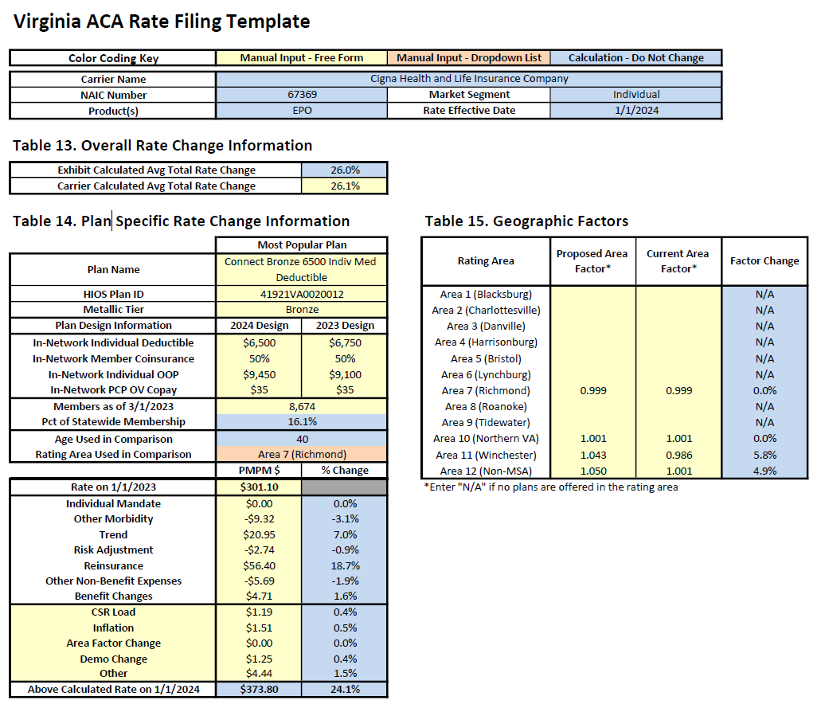
Cigna Health and Life Insurance Company Individual
Presenter:
Cathy Wang,
Actuarial Advisor

Slide 22
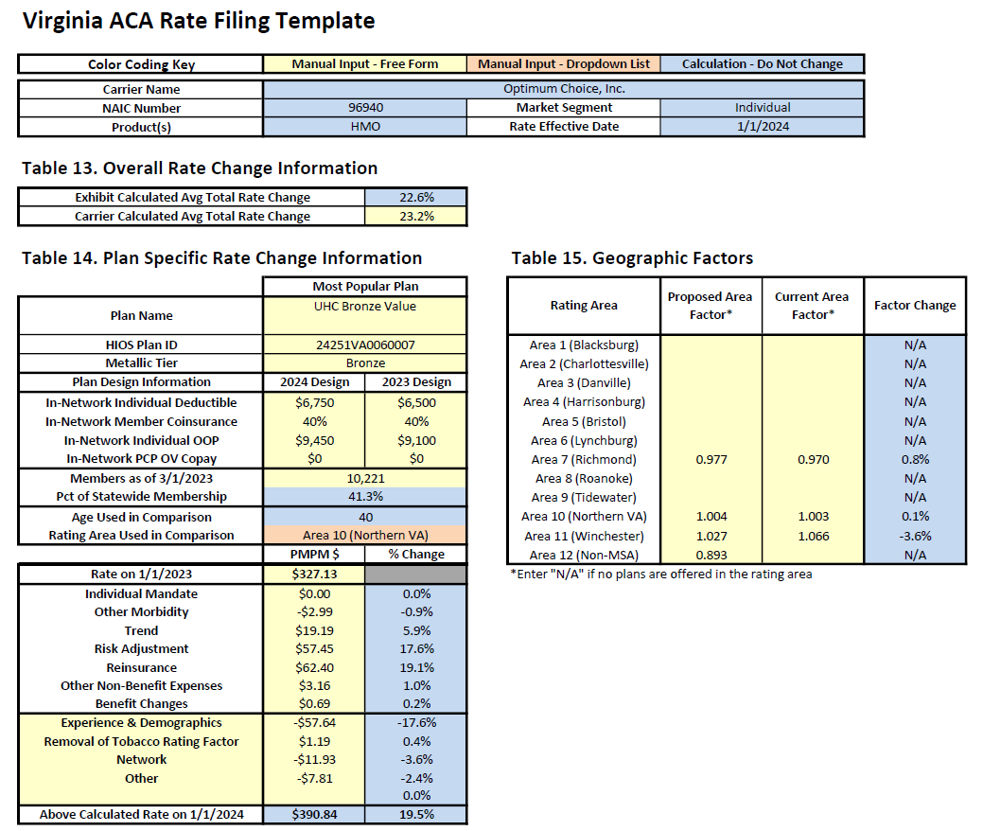
Optimum Choice, Inc. Individual
Presenter:
Katherine Simon
Director of Actuarial Services

Slide 23
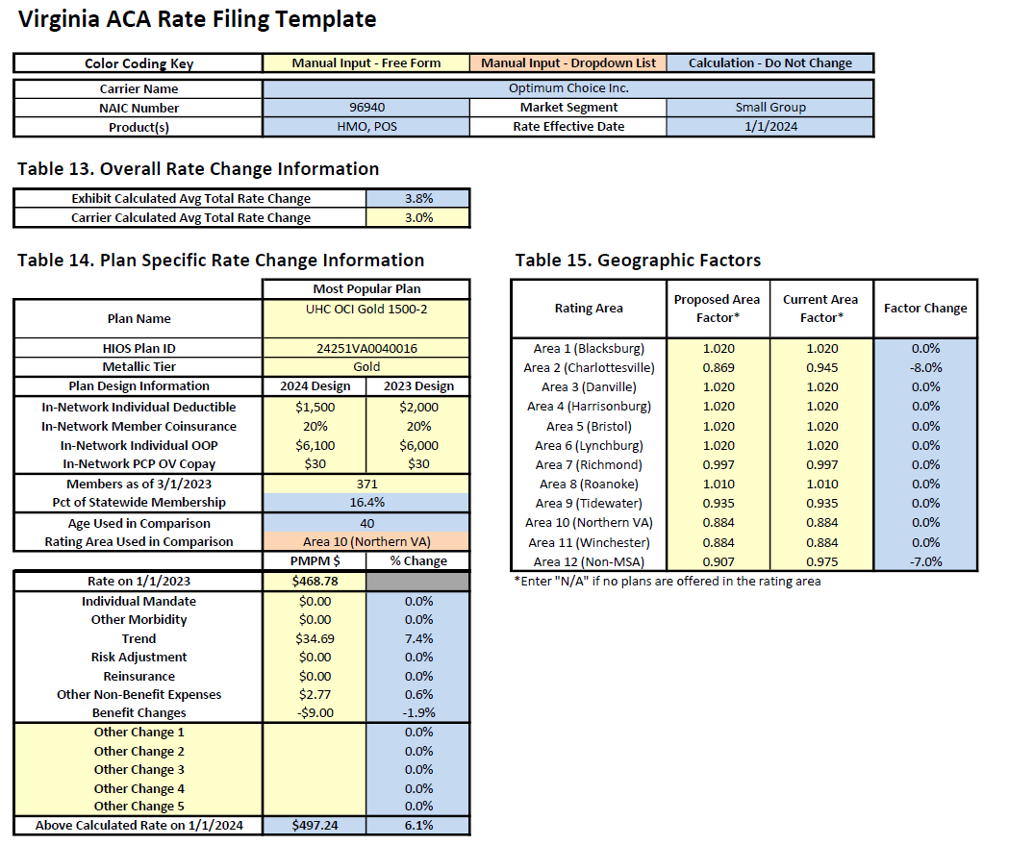
Optimum Choice, Inc. Small Group
Presenter:
Katherine Simon
Director of Actuarial Services

Slide 24

Sentara Health Plans Individual
Presenter:
Margaret Chance,
Principal and Consulting Actuary

Slide 25
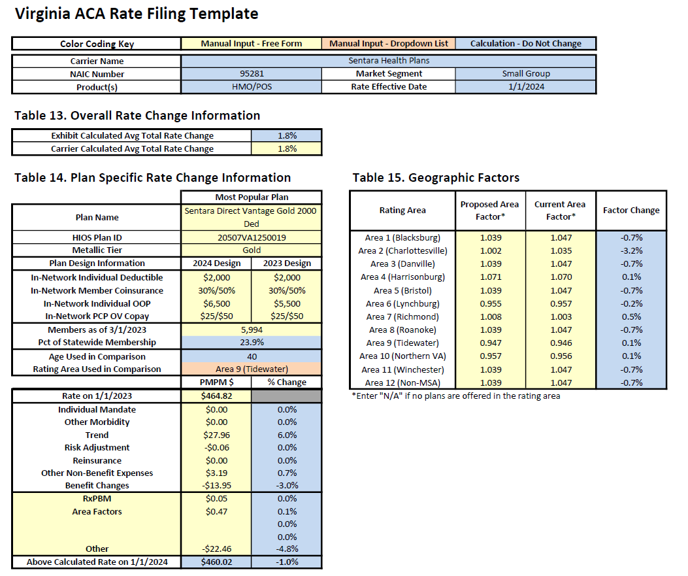
Sentara Health Plans Small Group
Presenter:
Margaret Chance,
Principal and Consulting Actuary

Slide 26
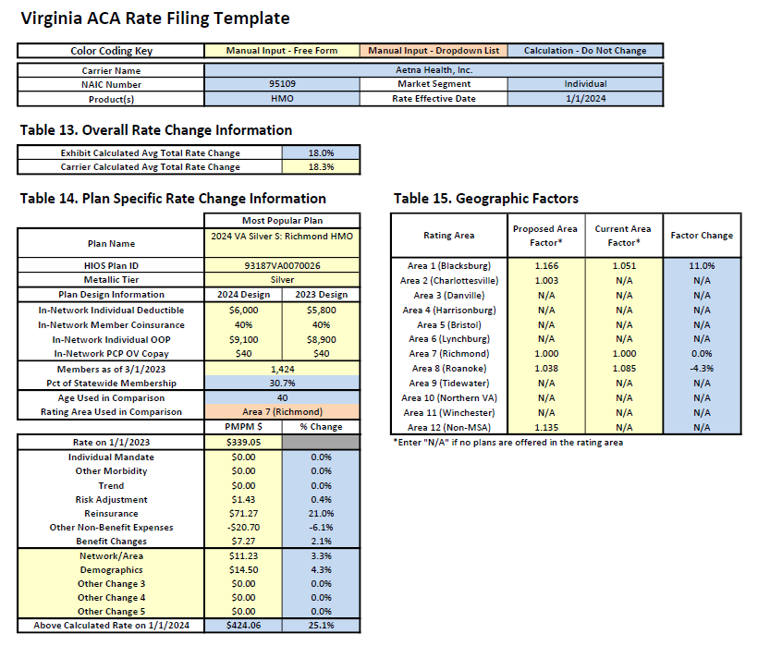
Aetna Health, Inc. Individual

Slide 27
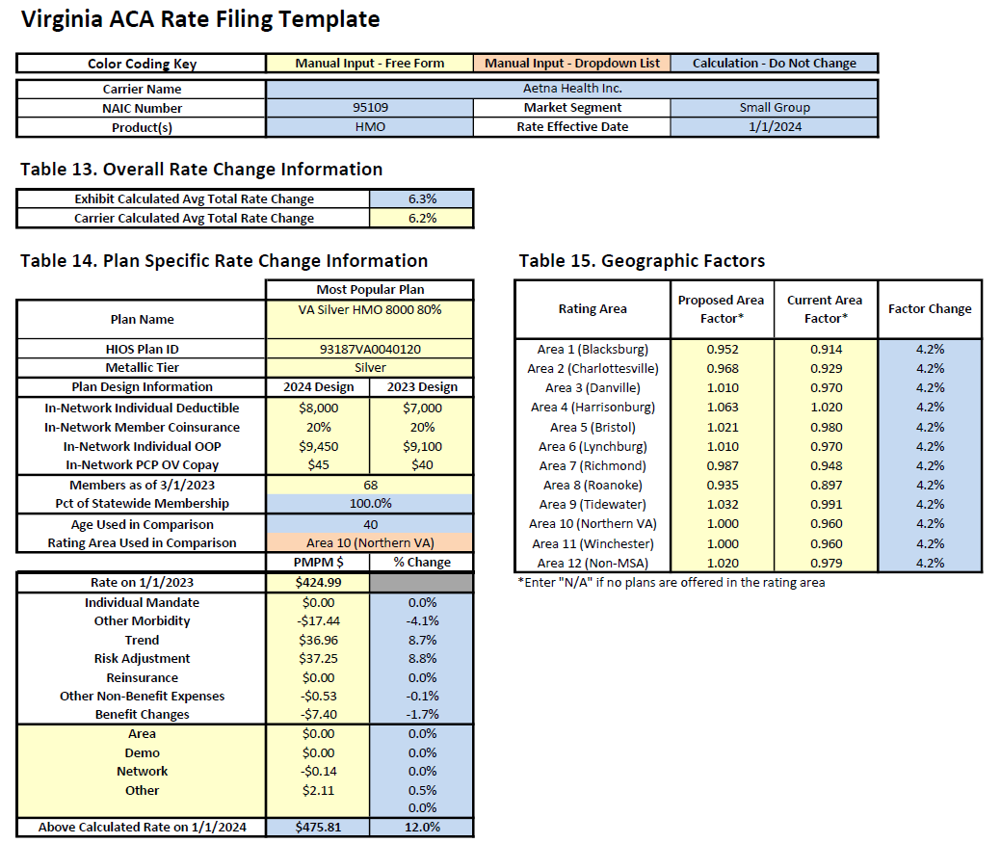
Aetna Health, Inc. Small Group

Slide 28
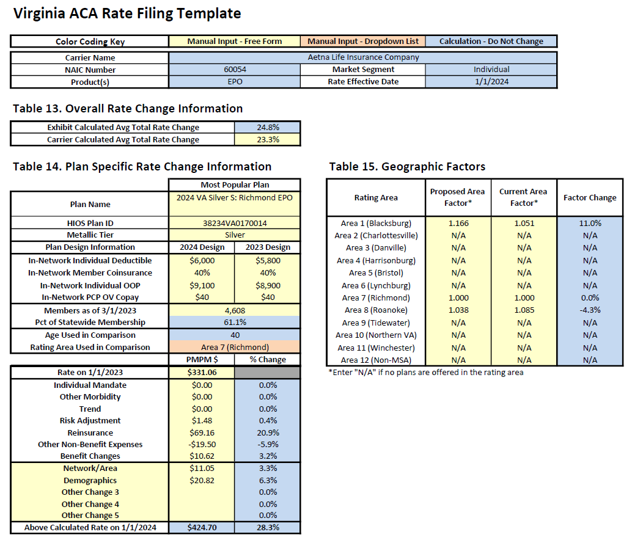
Aetna LIFE INSURANCE Company Individual

Slide 29
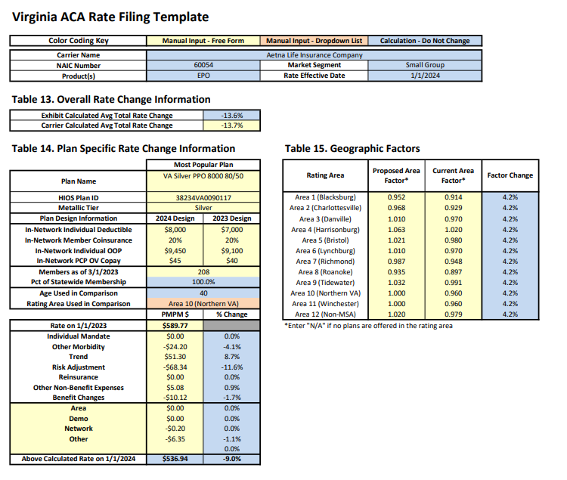
Aetna LIFE INSURANCE Company Small group

Slide 30
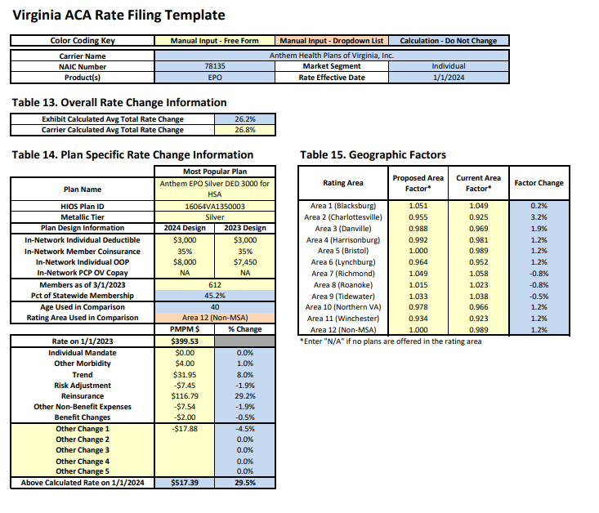
Anthem health plans of Virginia, inc. individual

Slide 31
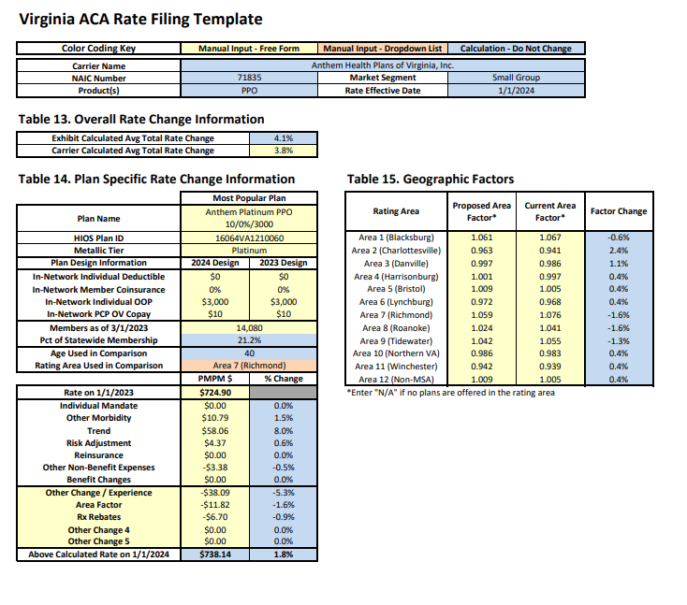
Anthem health plans of Virginia, inc. Small group

Slide 32
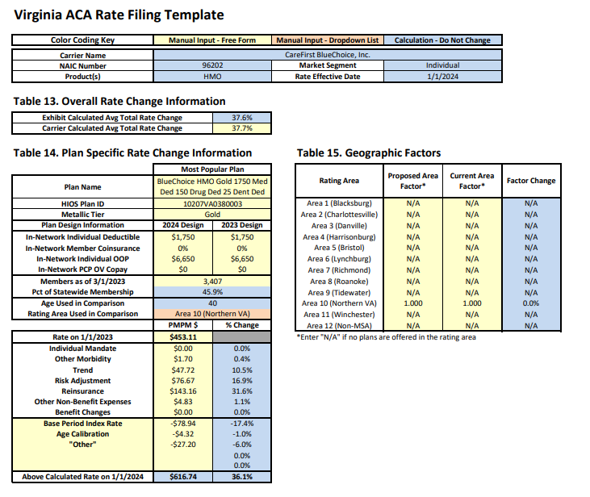
Carefirst bluechoice, inc. individual

Slide 33
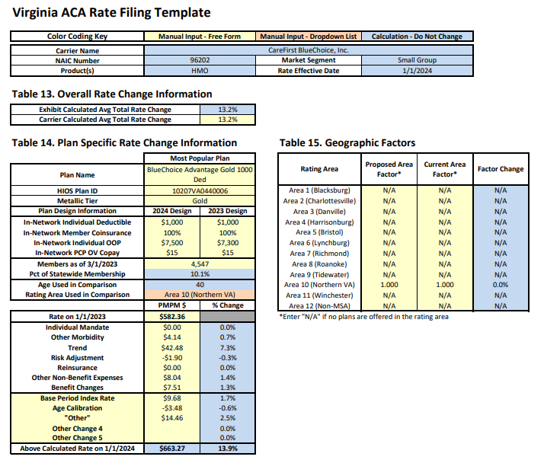
Carefirst bluechoice, inc. small group

Slide 34
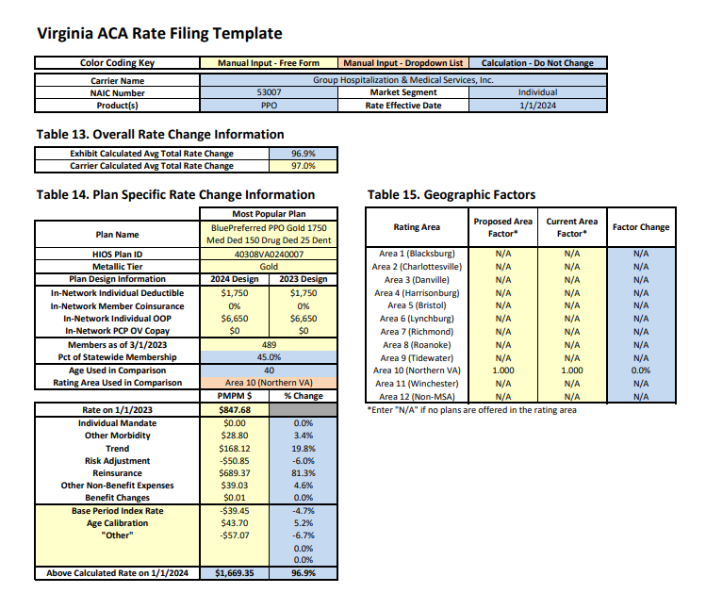
Group hospitalization & medical services, inc. individual

Slide 35
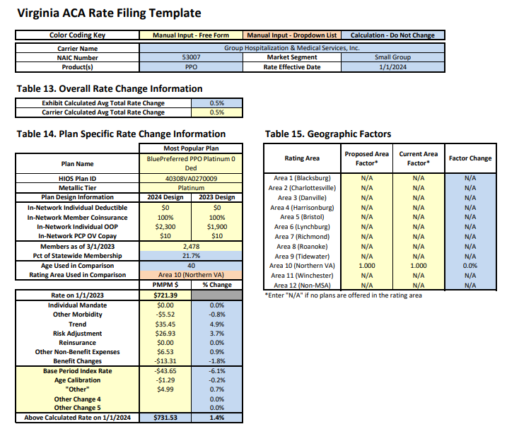
Group hospitalization & medical services, inc. small group

Slide 36
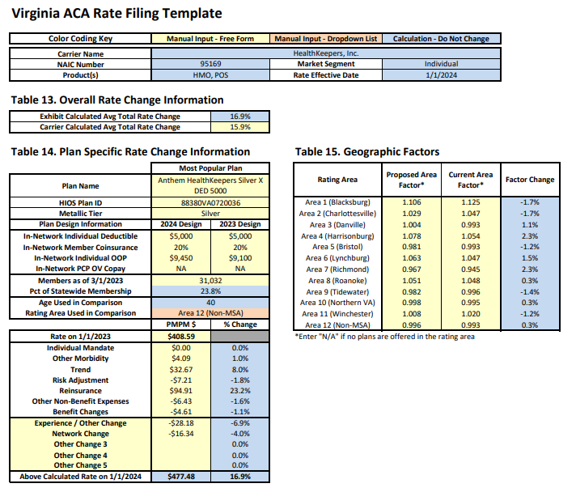
Healthkeepers, inc. individual

Slide 37
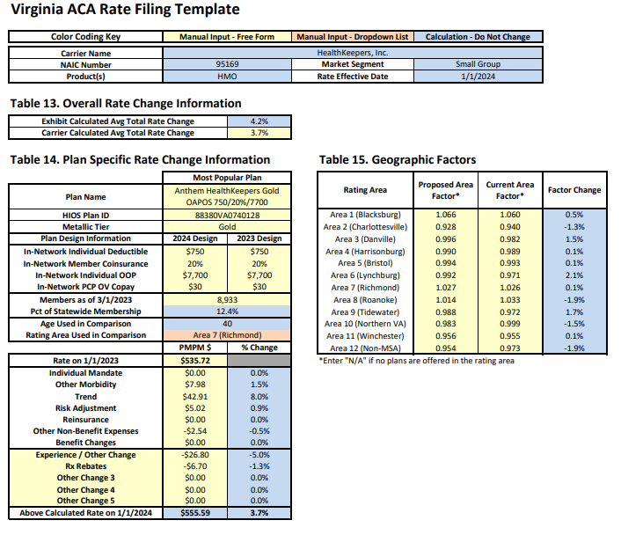
Healthkeepers, inc. small group

Slide 38
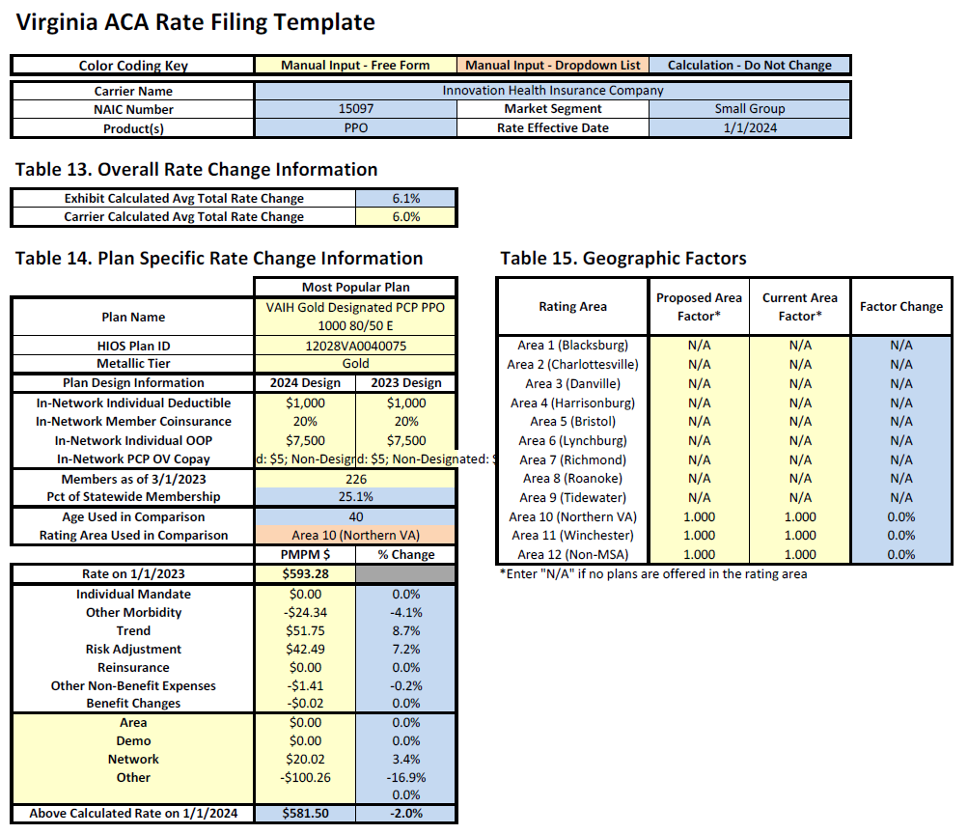
Innovation health insurance company small group

Slide 39
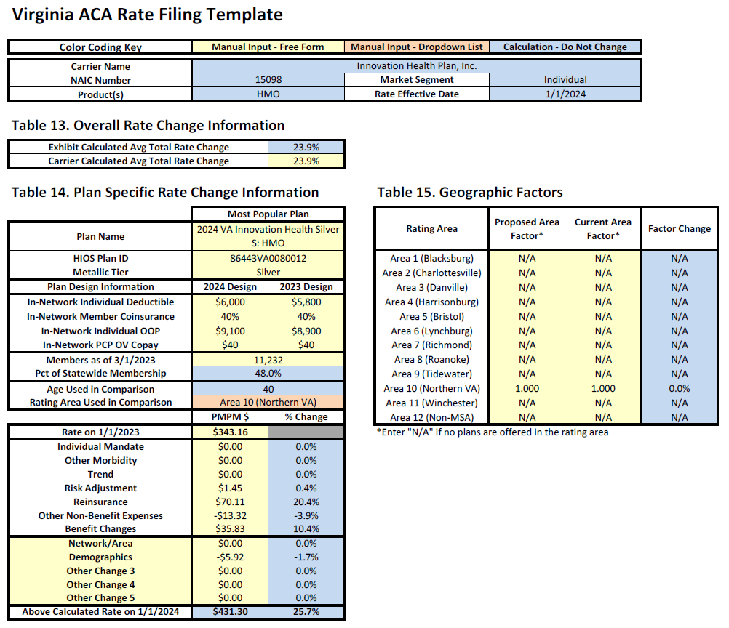
Innovation health plan, inc. individual

Slide 40
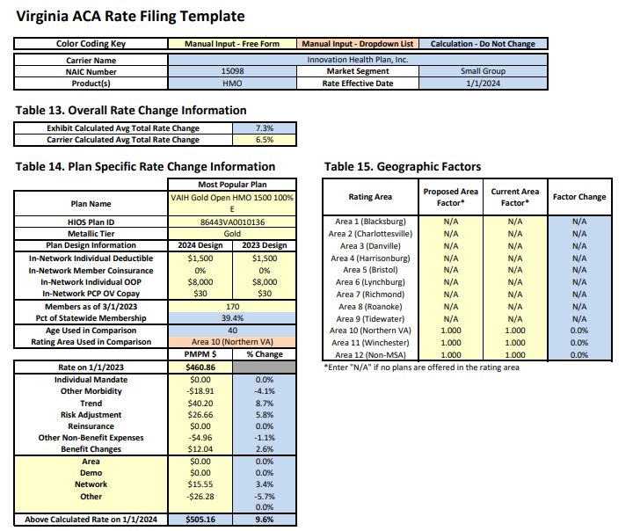
Innovation health plan, inc. small group

Slide 41
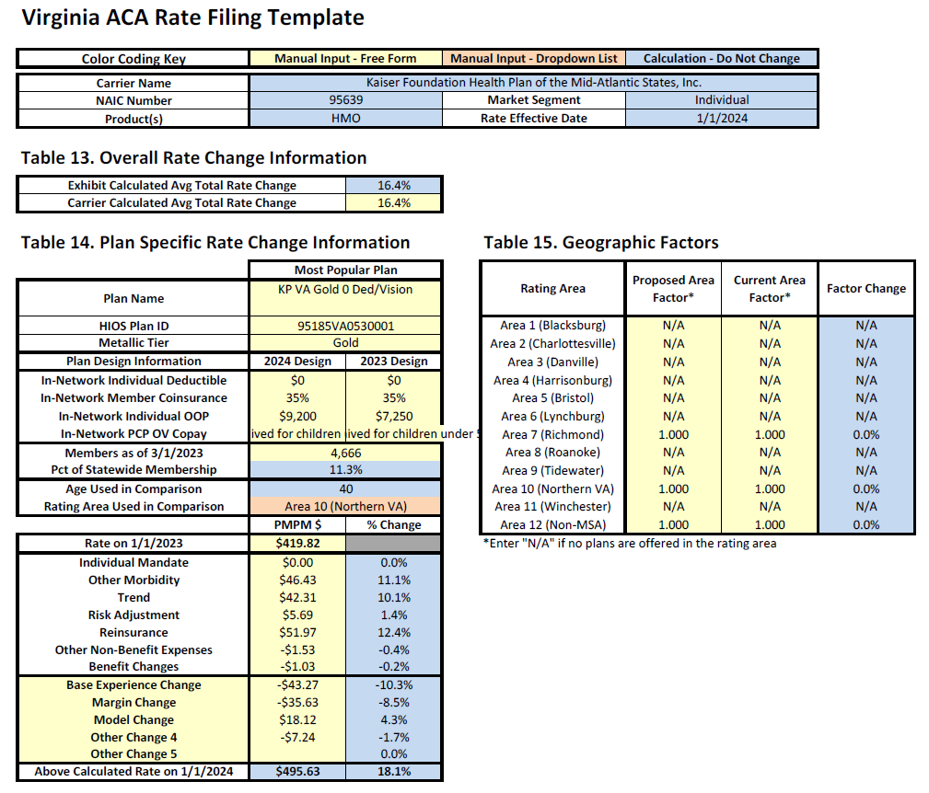
Kaiser foundation health plan of the mid-Atlantic states, inc. individual

Slide 42
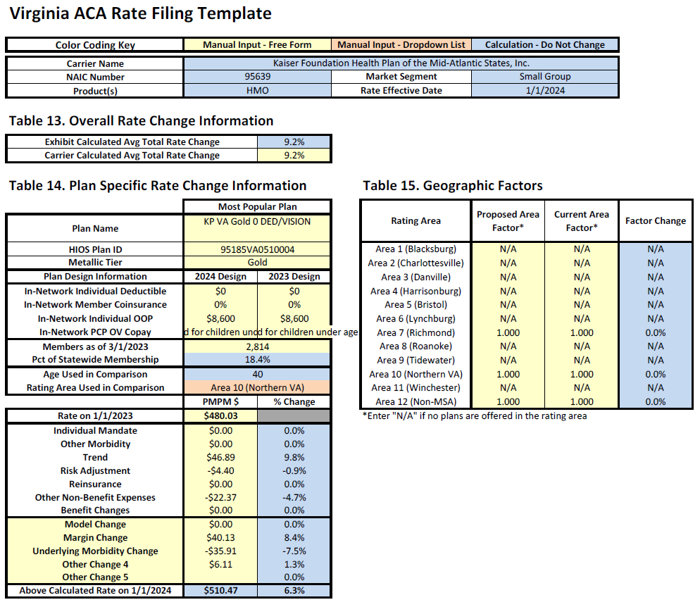
Kaiser foundation health plan of the mid-Atlantic states, inc. small group

Slide 43

Oscar insurance company individual

Slide 44

Piedmont community healthcare hmo, inc. individual

Slide 45

Piedmont community healthcare hmo, inc. small group

Slide 46
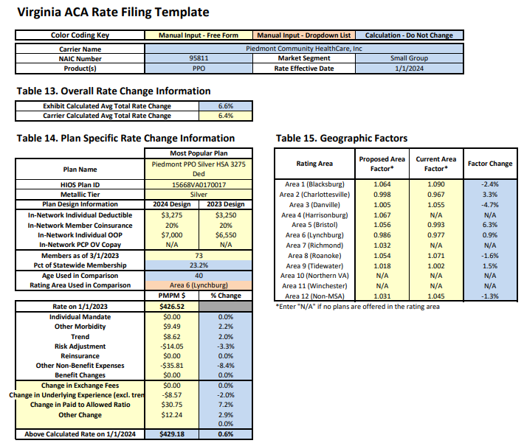
Piedmont community healthcare, inc. small group

Slide 47

sentara health insurance company individual

Slide 48

sentara health insurance company small group

Slide 49

Unitedhealthcare insurance company small group

Slide 50

Unitedhealthcare of the mid-Atlantic, inc. small group

Slide 51
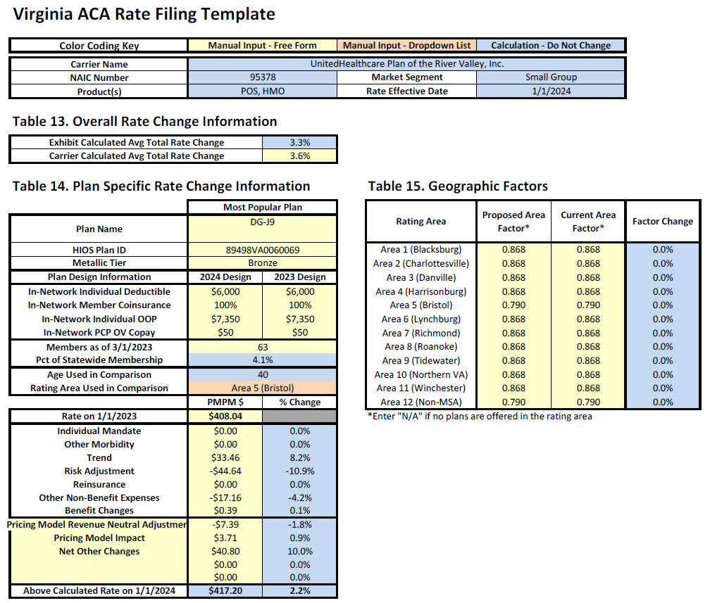
Unitedhealthcare plan of the river valley, inc. small group

