Slide 1

Balance Billing - Arbitration Process
State Corporation Commission

Slide 2
Overview
If an enrollee is treated by an out-of-network provider for emergency services or at an in-network facility for scheduled services covered by Virginia's balance billing law the provider or facility that is out-of-network will submit a claim to the enrollee's insurance carrier.
The amount the insurance carrier pays the facility or provider must be a “commercially reasonable amount” based on payments for the same or similar services in a similar geographic area. If the insurance carrier and the provider cannot agree on the amount, either party can start the arbitration process.
Commercially Reasonable Payments Data Set and Protocols
Notes:
Data Set Effective: January 1, 2021 – December 1, 2021
An “insurance carrier” includes an elective group health plan or the elective group health plan through its administrator.

Slide 3
Involved Parties
Initiating Party (IP):
Insurance Carrier, or
Non-Initiating Party (NP):
Insurance Carrier, or
Out-of-Network Provider
Arbitrator
Out-of-Network Provider
Notes:
Arbitrator – Determines the final payment amount the insurer or provider must accept by choosing one of the parties' best final offer.

Slide 4
Arbitration Timeline
 | Day 0 | Out-of-network provider submits clean claim to carrier/payer.
On or before | Day 30 | Carrier/payer pays or offers to pay out-of-network provider.
On or before | Day 60 | Provider may dispute initial payment or payment offer by notifying carrier/payer. Parties are engaged in good faith negotiation.
On or before | Day 70 | Carrier/payer or provider can request arbitration by sending Notice of Intent to Arbitrate (NIA) form to the SCC and to the non-initiating party (NP). Initiating party (IP) must include their final offer with request.
On or before | Day 80 (10 business days from Day 70) | Nondisclosure agreement signed within 10 business days after request to initiate arbitration is made.
On or before | Day 90 | Arbitrator is chosen. Reviewer notifies initiating and non-initiating parties of chosen arbitrator and copies chosen arbitrator.
On or before | Day 100 | Both parties must make written submissions in support of final offer.
On or before | Day 100 | Parties each pay arbitrator their half of the applicable fee.
On or before | Day 115 | Arbitrator issues decision.
On or before | Day 125 | Claim payment is made.
Notes:
Note: Parties can come to an agreement at any time during the process. Claim must be paid within 10 days of agreement.

Slide 5
Good Faith Negotiation Period
Provider must notify the insurance carrier in writing of a claim dispute within 30 days of the initial payment or payment offer, whichever is earlier.
Both parties should engage in a good faith negotiation period during this 30 day period.
If the insurance carrier and out-of-network provider cannot agree on the payment during the 30 day period, one of the parties can request the claim dispute be settled through arbitration.

Slide 6
Arbitration Process (Within 40 Days)
Within 10 days of the end of a good faith negotiation period, and within 40 days of the earlier of the initial payment or payment offer:
Initiating Party (IP) files Notice of Intent to Arbitrate (NIA) form to BBVA@scc.virginia.gov
IP must include their final offer with request.
IP submits NIA form to Non-initiating Party (NP)
Arbitrator contact information at the managed care plans is provided on the Bureau’s website. If the NP is an elective group health plan, use the contact persons for inquiries from the elective group health plan search online.

Slide 7
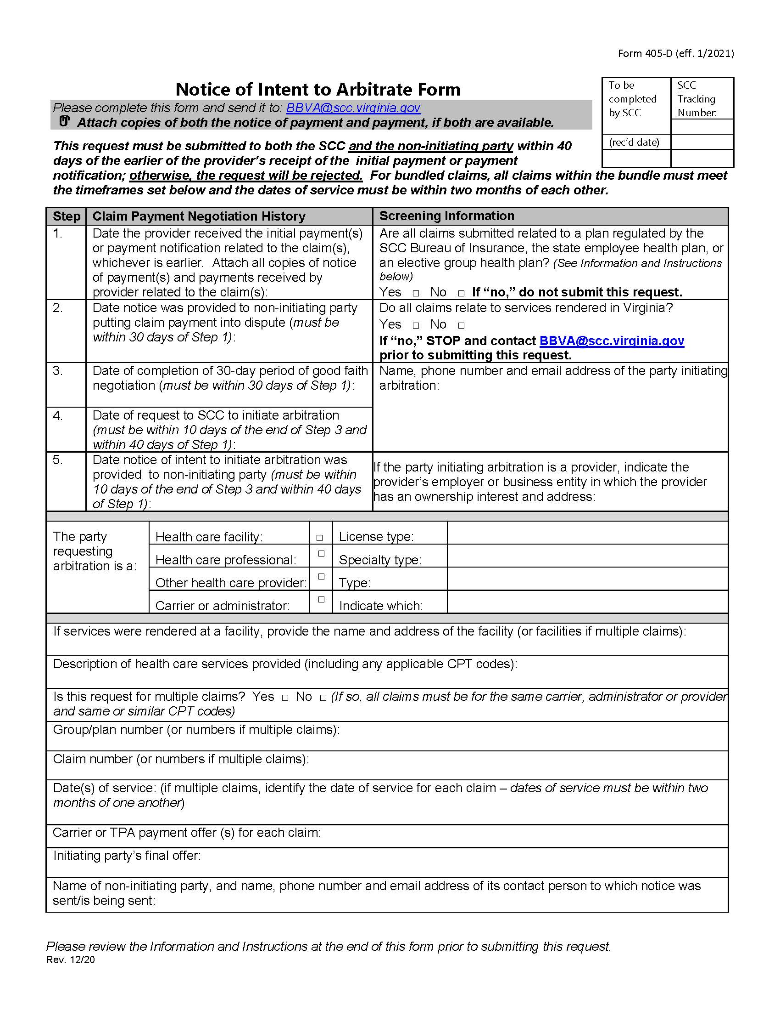
Notice of Intent to Arbitrate (NIA) Form
Notes:
Link to NIA form: Notice arbitration requested (virginia.gov)

Slide 8
Application Information
Attach copies of both initial payment and payment offer, if both are available.
Only claim payments made in connection with managed care plans regulated by SCC, the state employee health plan, and elective group health plans can use the arbitration process.
Not included: Medicare, Medicaid and Federal Employee Health Benefit Plans.
Elective group health plans are plans that are self-funded and are not regulated by Virginia. In order to offer balance billing protections for their enrollees, the plan must opt-in to the balance billing law. Search the list of elective group health plans

Slide 9
Review of NIA Form
Upon submission, the NIA will be reviewed for the following:
Form is completed in full.
Ensure all deadlines have been met.
Copies of payment or payment notice are included. (Do NOT include PII).
Notice was provided to NP of a claim dispute.
The 30-day good faith negotiation period was completed.
The NIA was submitted and provided to NP.

Slide 10
Rejected NIA
If submission fails at any point, the NIA will be rejected and a return email to IP and NP will explain the reason rejected, and that balance billing is prohibited under Virginia law.
If submission fails for some but not all claims within a bundle (i.e., some claims fall outside of the 40-day deadline for NIA submission), the email will indicate which claims do not meet the requirements. Process will continue for the other claims.

Slide 11
Approved NIA
The Reviewer will send an email to both the IP and the NP that:
Acknowledges acceptance of a request for arbitration;
Both parties must choose an arbitrator from a list of arbitrators approved by the SCC. If the parties cannot agree, the SCC will choose one and notify the parties.
Reminder that both parties are required to agree to and execute a nondisclosure agreement within 10 business days of the NIA form; and
For requests that include bundled claims, the NP should work with the IP to discuss any claims it determines as ineligible within a bundle. Any disputes related to bundled claims may be included in the parties’ written submission to the arbitrator.
Notes:
If the parties cannot agree on an arbitrator, the SCC will choose an arbitrator and notify the parties, using the process outlined in § 38.2-3445.02 of the Code of Virginia and 14 VAC 5-405-40.

Slide 12
Choosing an Arbitrator
The IP must email BBVA of either an arbitrator choice or the inability of the parties to reach agreement within 5 calendar days of the NIA submission.
If both parties do not agree, the reviewer will:
Choose 5 arbitrators randomly from the list of arbitrators approved by SCC and email list to both parties. Each party will have 5 days from receipt of the emailed list to notify BBVA of up to 2 arbitrators they wish to remove from list.
Within 5 days of list provided, the Reviewer will consider the one remaining arbitrator or choose from the remaining arbitrators.

Slide 13
Notification of Chosen Arbitrator
Reviewer will notify by email both parties of chosen arbitrator and copies selected arbitrator. The Reviewer will email:
A copy of the NIA form;
Total arbitration fee (carrier and provider divide the fee equally);
Deadline for the parties to pay the fee to the arbitrator (within 10 days of this notification);
Reminder for both parties to make written submissions to the arbitrator (within 30 days of the NIA form), and the NP must provide its final offer to the IP;
Reminder that a party that fails to make timely written submissions will be in default and agrees to pay the final offer submitted by the non-defaulting party. The arbitrator may require the defaulting party to pay the entire arbitration fee.

Slide 14
Arbitration Decision
No later than 15 calendar days after the receipt of the parties’ written submissions, the arbitrator will:
Notify the BBVA and the parties of its decision via the Arbitrator Decision Reporting Form, and
Issue a written decision requiring payment of the final offer amount of either the IP or NP.
Parties may appeal an arbitration decision within 30 days of the decision by emailing BBVA. The appeal must relate to one of the reasons outlined in 14 VAC 5-405-40 H.
Notes:
Link to Arbitrator Decision Reporting Form: Notice for arbitrators to report decisions (virginia.gov)

Slide 15

Need Help?
Industry Website: scc.virginia.gov/pages/Balance-Billing-(1)
Email: BBVA@scc.virginia.gov
Questions related to arbitrator application, requests to arbitrate, or questions regarding the self-funded opt-in process
Consumer Website: scc.virginia.gov/pages/Balance-Billing-Protection
Bureau of Insurance: 1-877-310-6560
Email: BureauofInsurance@scc.virginia.gov
Consumer questions and complaints about balance billing

